Slide 1
Xero Application
By: Misha Patel
Sharukh Saiyad
Mayank Singh
Anvika Muthineni

Slide 2
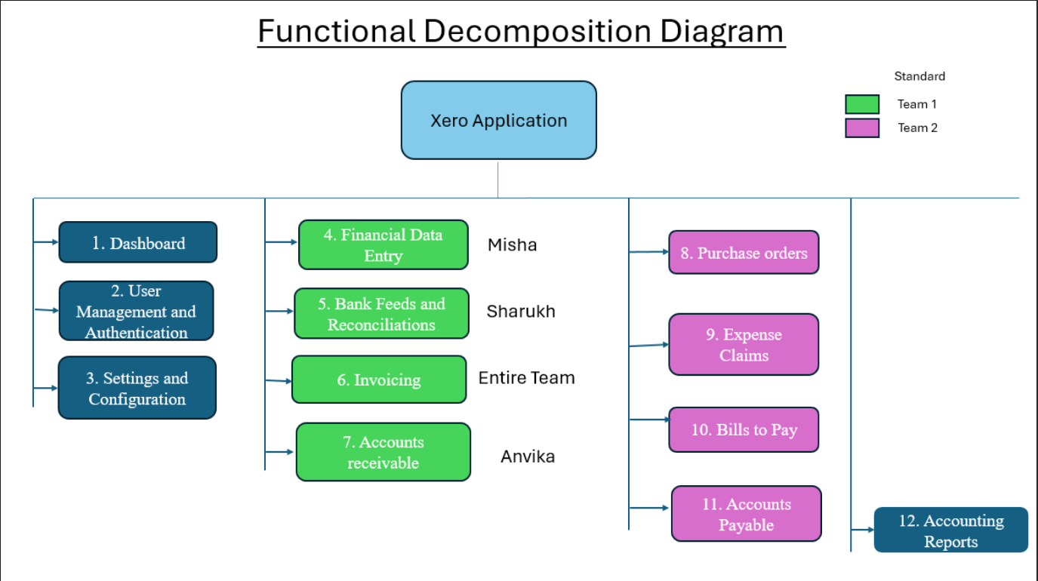
Functional Decomposition Diagram(Anvika)

Slide 3
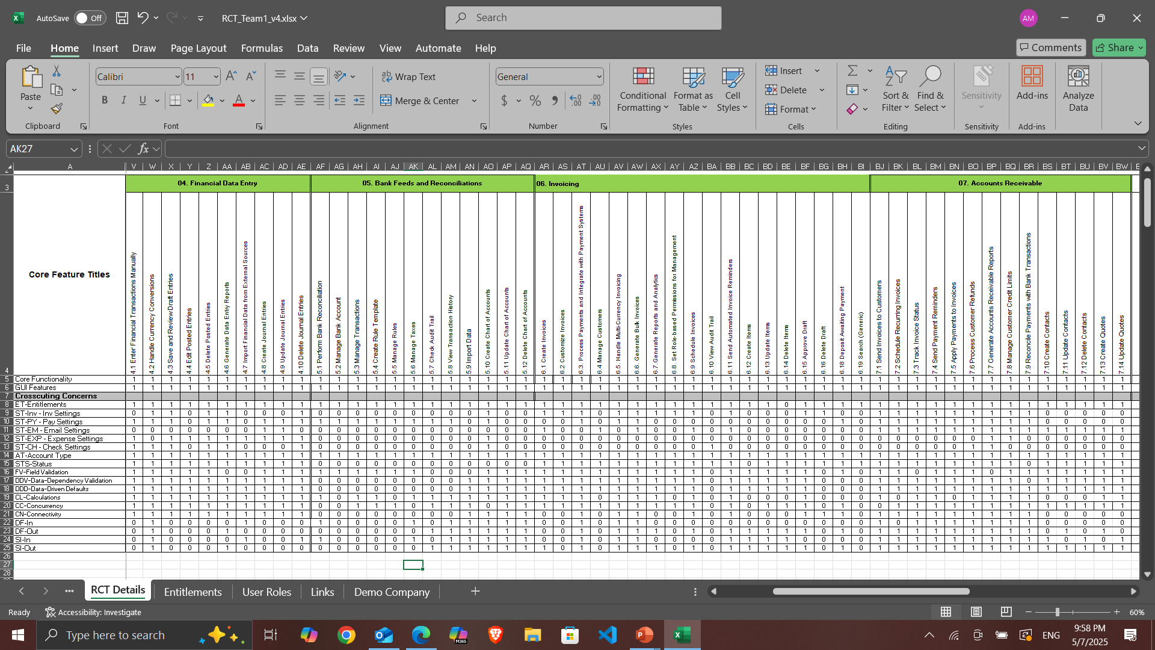
RCT (Shahrukh)

Slide 4
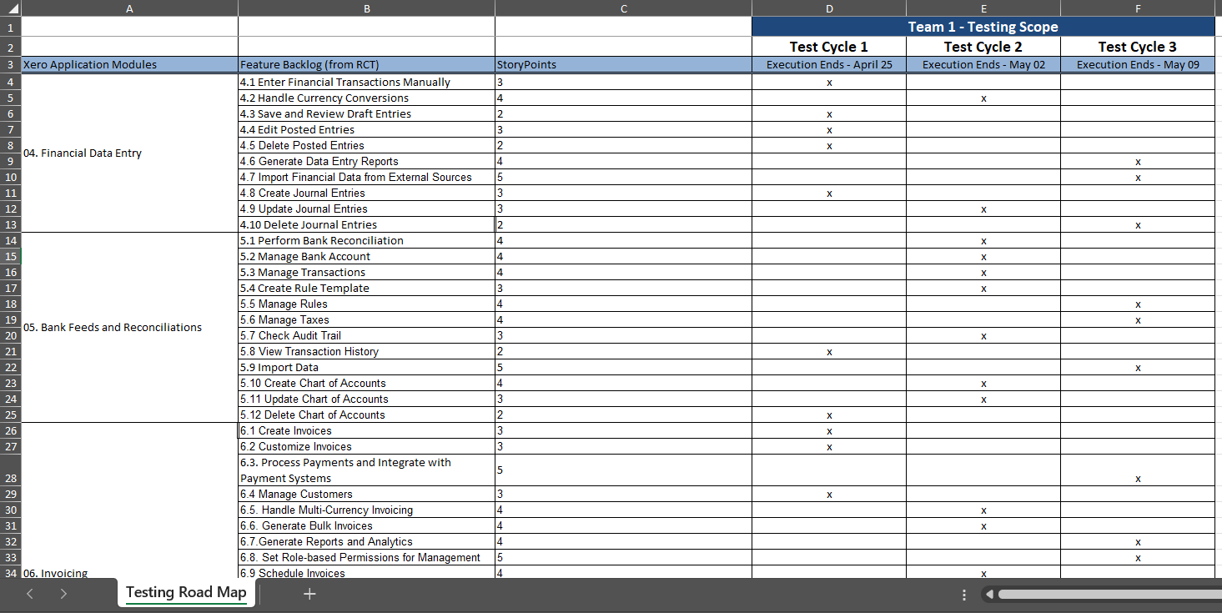
Testing Roadmap (Misha)

Slide 5
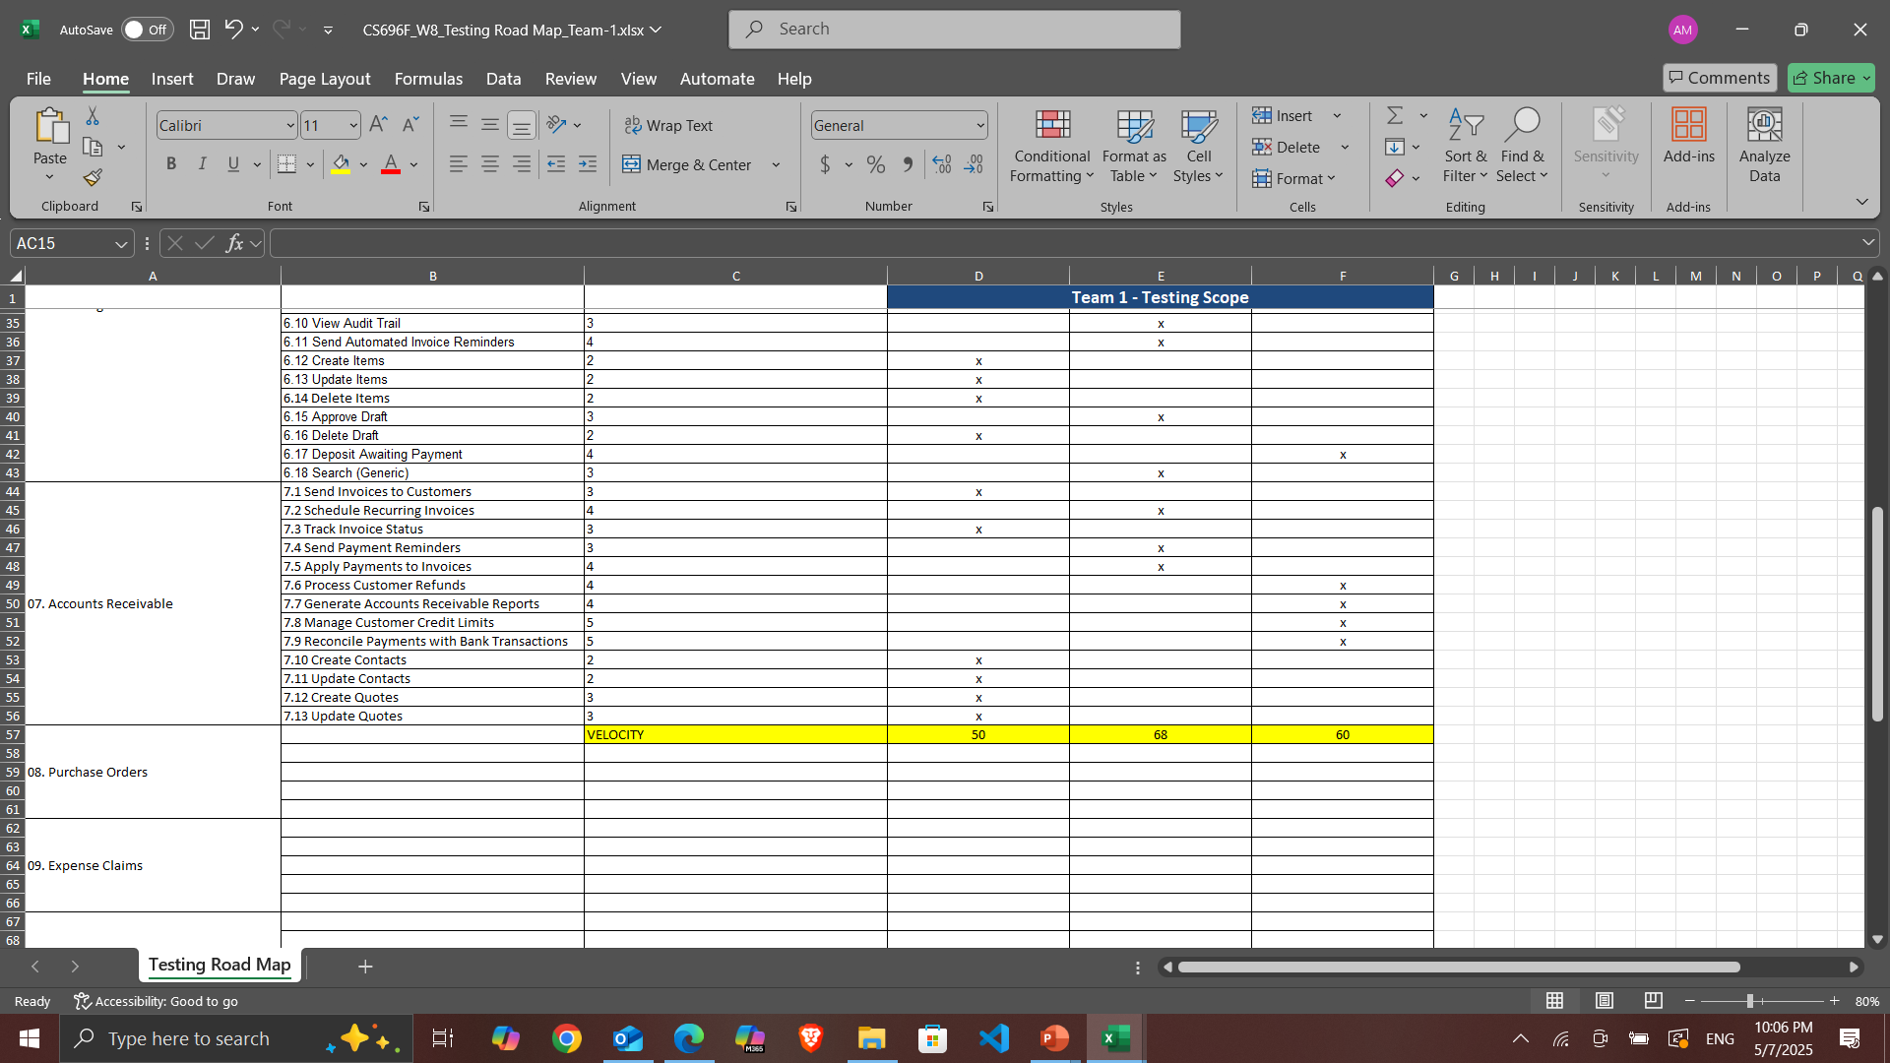

Slide 6
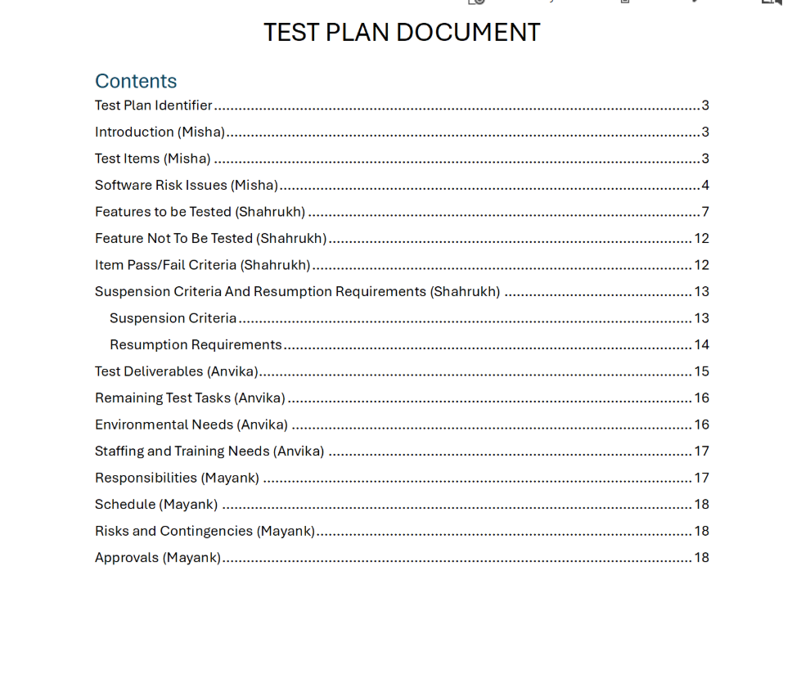
Testing Plan (Mayank)

Slide 7
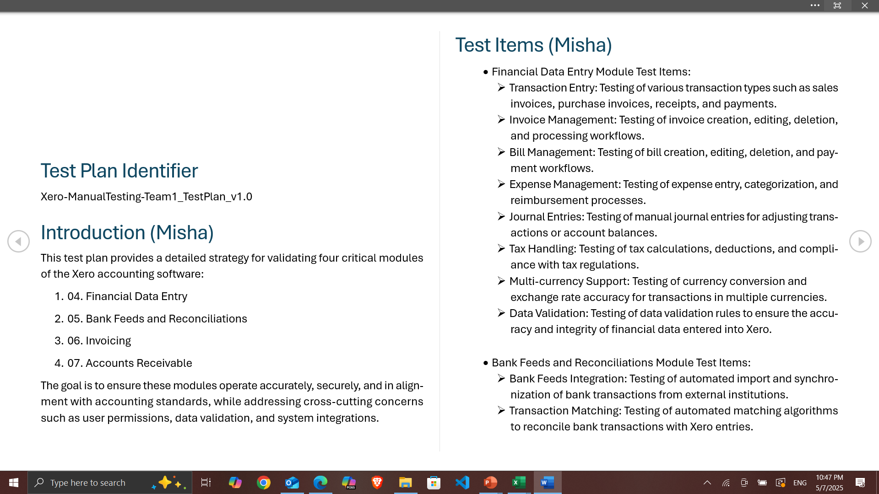
Testing Plan

Slide 8
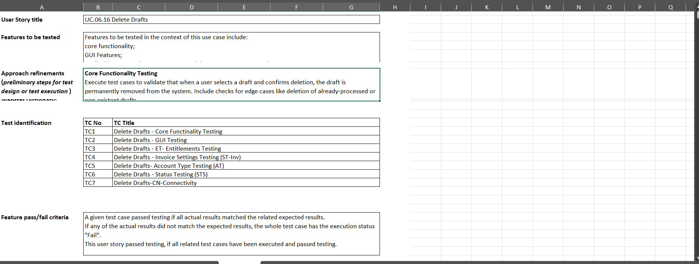
Test Design Specification

Slide 9
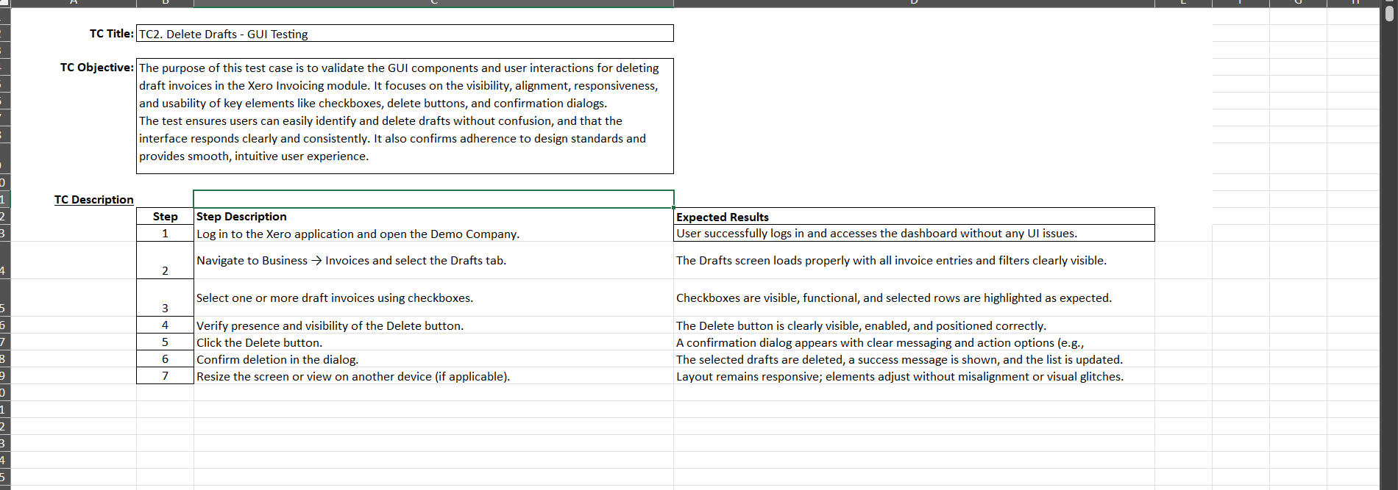
Test Case Specification

Slide 10
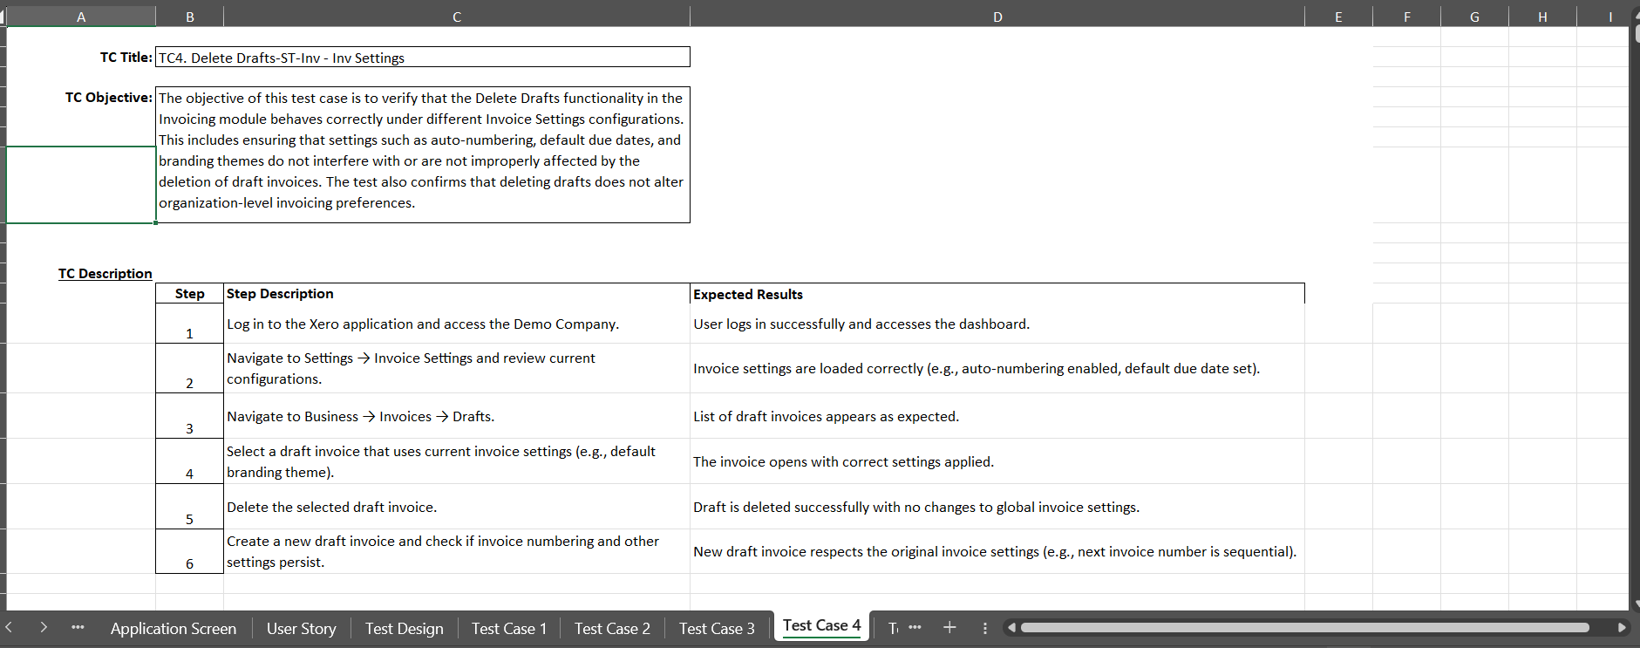
Test Case Specification

Slide 11
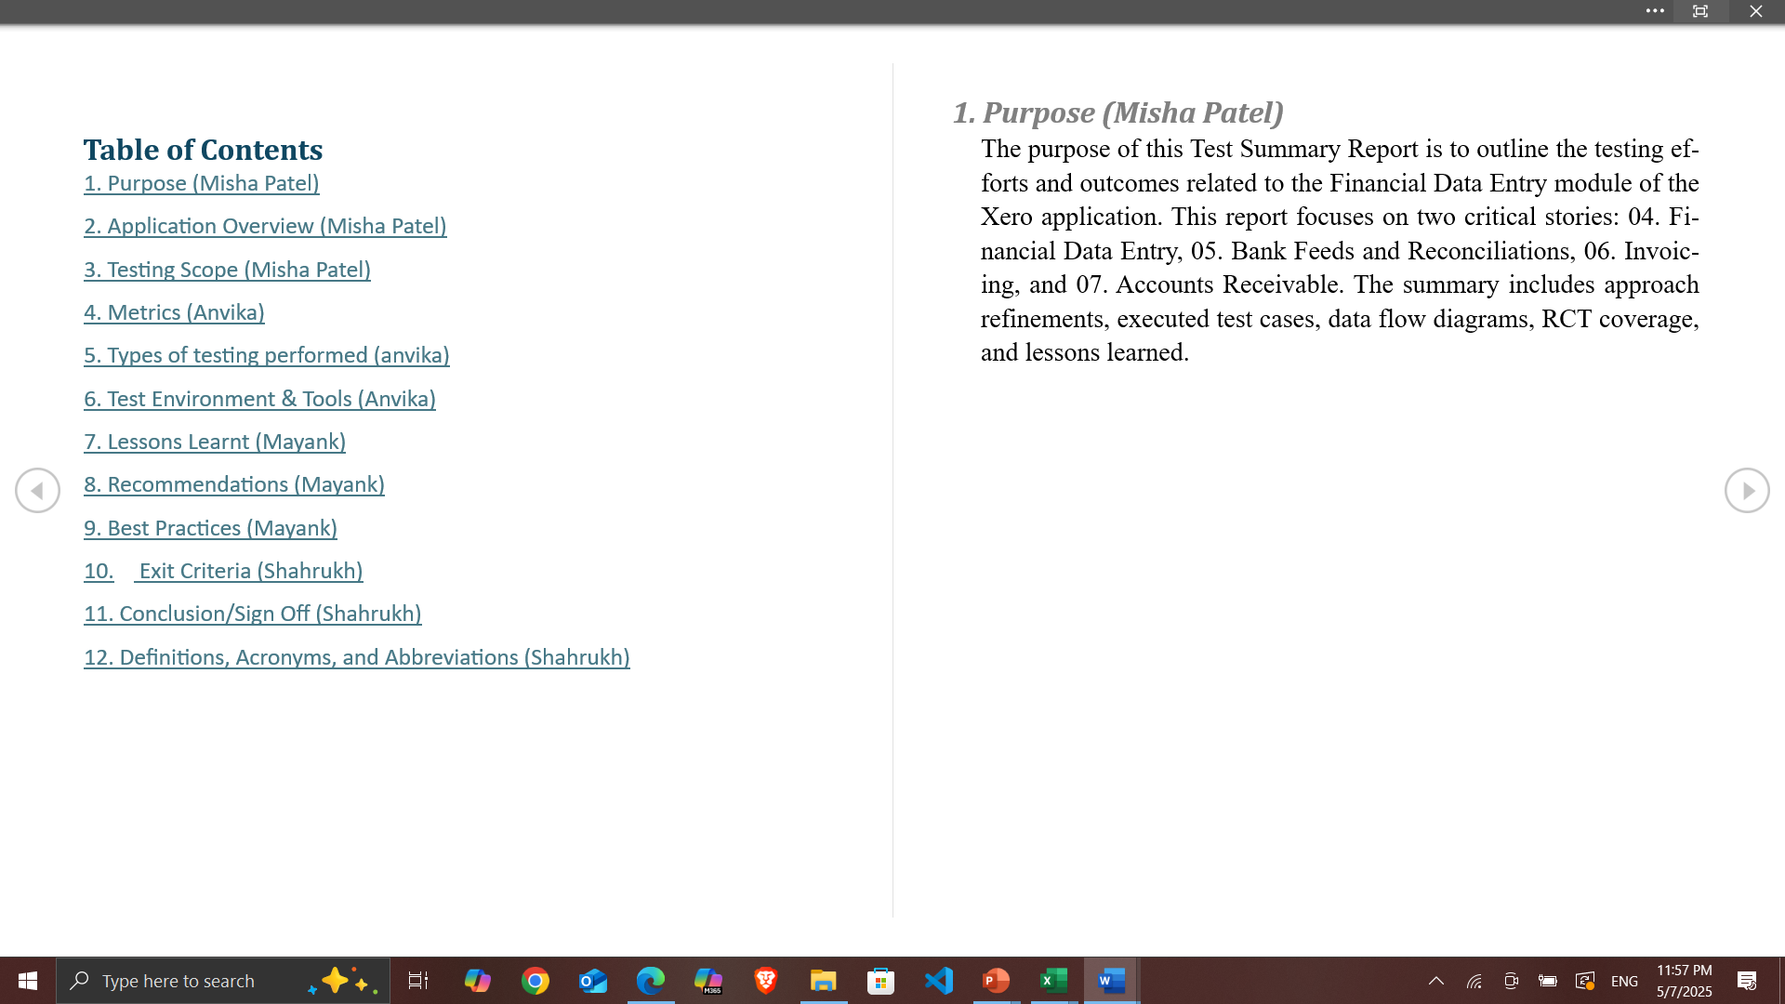
Test Summary Report

Slide 12
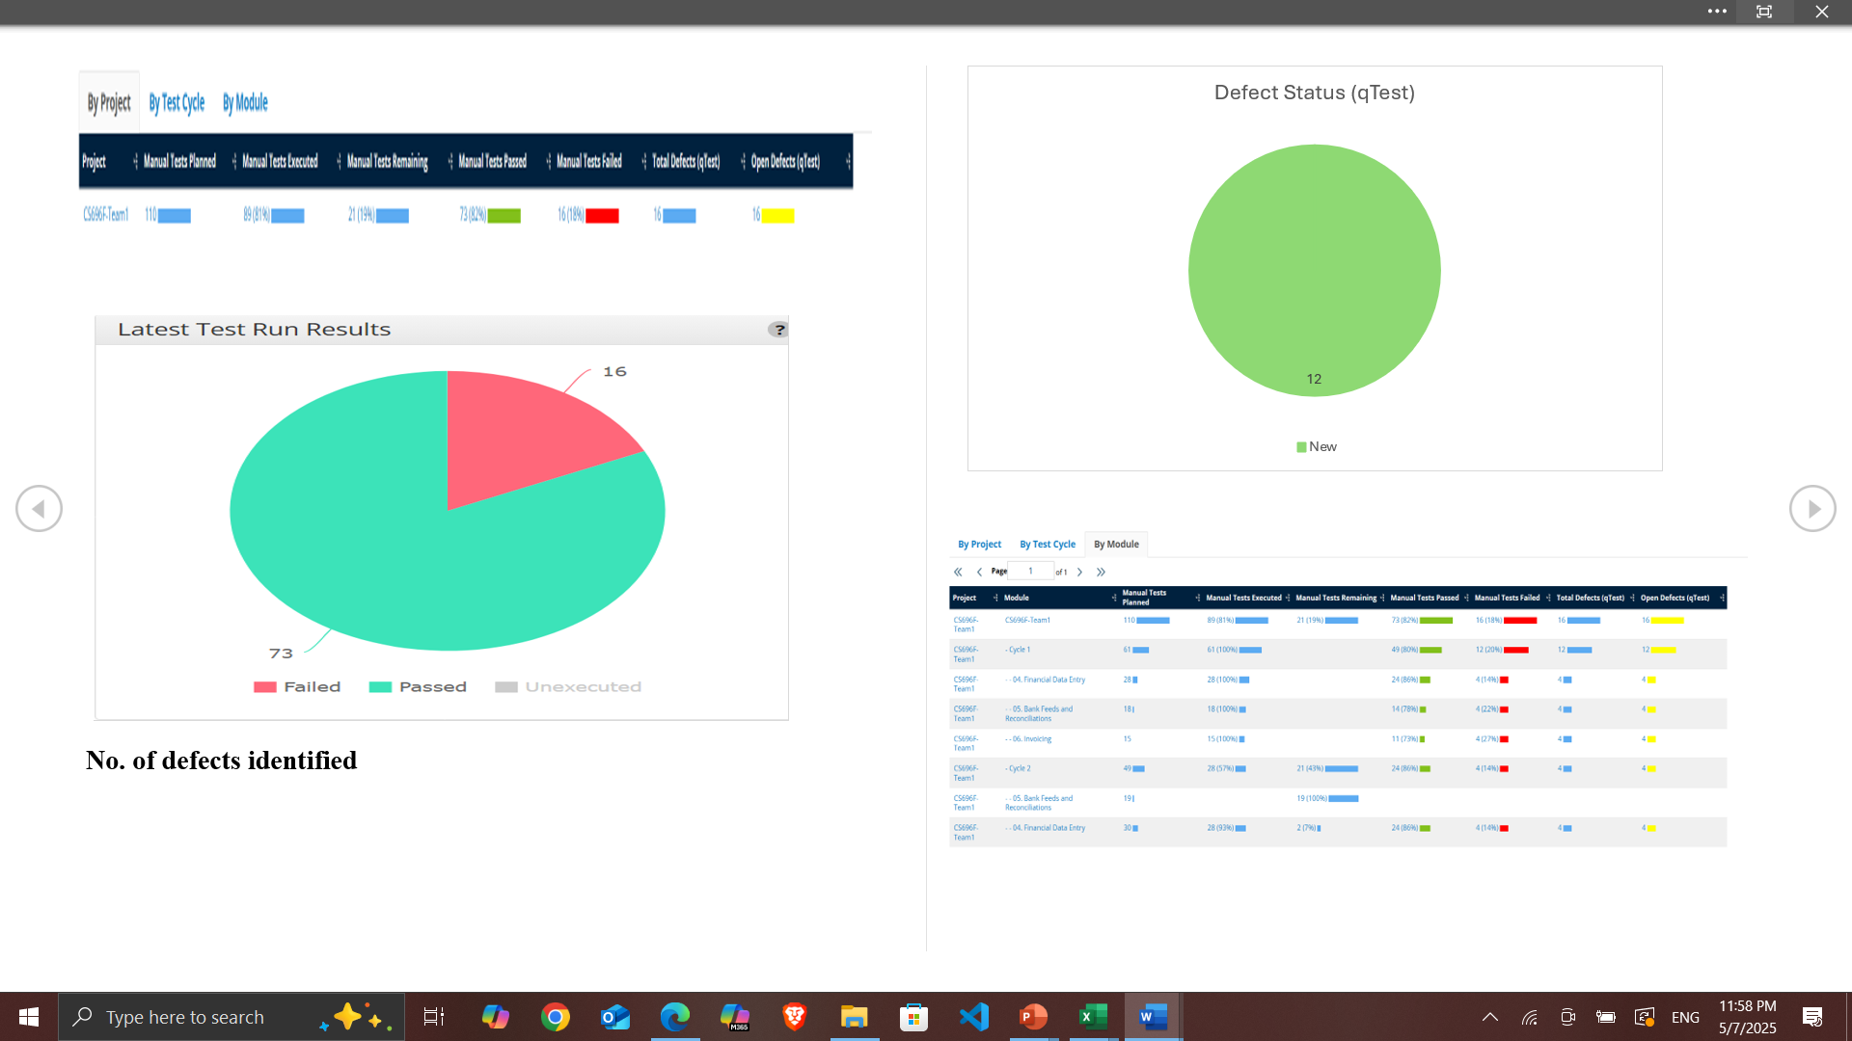

Slide 13
GitHub Repository Link
GitHub - mishapatel03/CS696F_AppliedSoftwareTesting_Team1_repo

Slide 14
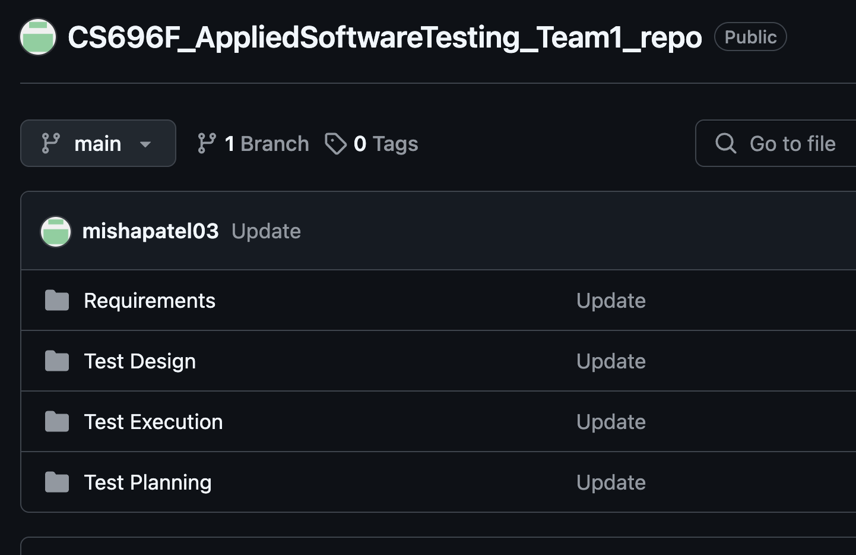
GitHub Repository Folder Structure

